Slide 1

Homework 2: Multiple Linear Regression for IMBD Data

Slide 2
Predictor Identification
Determine what variables would generate a higher IMDB score, led us to use most of the variables in the dataset. We decided to exclude the variables that included names of the movie, director, or actors because there were too many different names that it would be impossible for the name to be a good predictor. We left 4 categorical variables remaining that we later turned into dummy variables. We felt that these 4 categorical variables were helpful predictors to keep in determining if it generated a higher IMDB score. We included all but one of the numerical variables because we felt the raw data was our best way of developing our models. The one numeric variable we took out was budget due to the inconsistency of currency used in different countries.

Slide 3
Pre-Processing

Slide 4
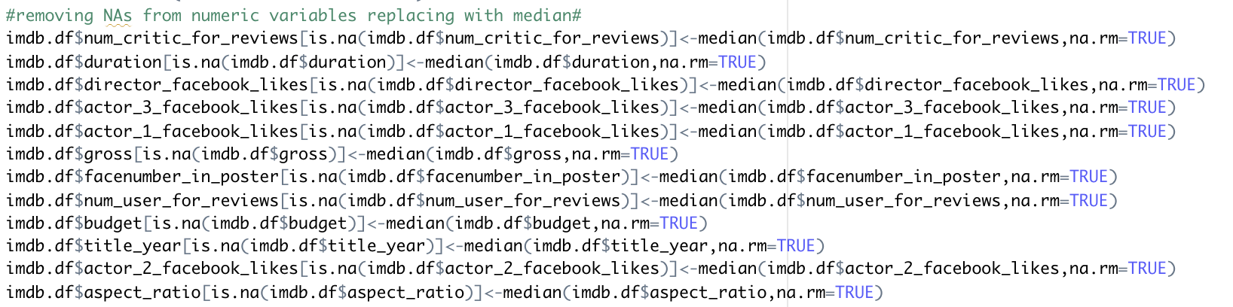
Detailed discussion of appropriate missing data
This method is going through each of the numerical columns and replacing the NA values with the median value of each variable. This is directly implemented into the imdb.df file that will allow our linear models to be ran without the NAs manipulating the results.

Slide 5

Category Reduction
Categories removed:
Director name- there are too many names that results in not correlating with a change in IMDB score
Actor 2 name- there are too many names that results in not correlating with a change in IMDB score
Genres- listed with overlapping words used for multiple movies making it difficult to use as a predictor
Actor 1 name- there are too many names that results in not correlating with a change in IMDB score
Movie title- completely unique variable
Actor 3 name- there are too many names that results in not correlating with a change in IMDB score
Plot keywords- not a categorical variable with a strong enough correlation to
IMDB link- no correlation to affecting the IMDB score
Budget- was removed because it has too many inconsistencies of currencies used.

Slide 6
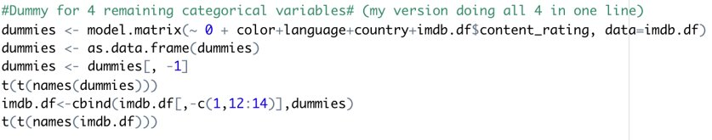
Dummy Variables
This code creates a dataset of the 4 remaining categorical variables in the form of dummy variables.
It is then combined into imdb.df and removes the categorical variables that was just created into a dummy variable.
This added each possibility of the four variables to the end acting as binary dummy variables to be used in our model.

Slide 7

Partition Data
Partitioned data into 60% training and 40% validation

Slide 8
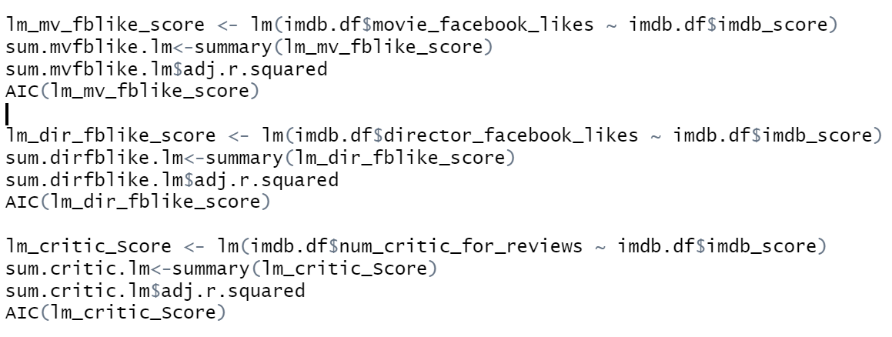
Simple Linear Regressions

Slide 9
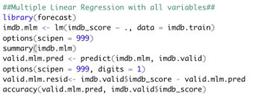
Full Model With All Predictors
This was the code used to build and analyze the IMDB score compared to all existing predictors in the data frame.
This also showed us the insignificant predictors for us to be able to take out.
On the next slide you can see the predictors we were taking out for a newer model.

Slide 10
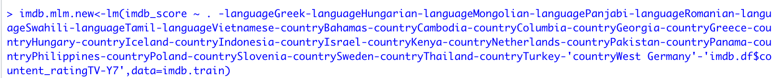
Full Model Excluding Insignificant Predictors
As you can see, there were quite a few insignificant predictors. Due to the way our dummy variable was set up, the linear model identified a lot of the individual columns aligned with the dummy variables as insignificant or even listed them as NA because there was not enough records of that type. This led us to want to remove all these variables for a newer updated multiple linear regression model.

Slide 11
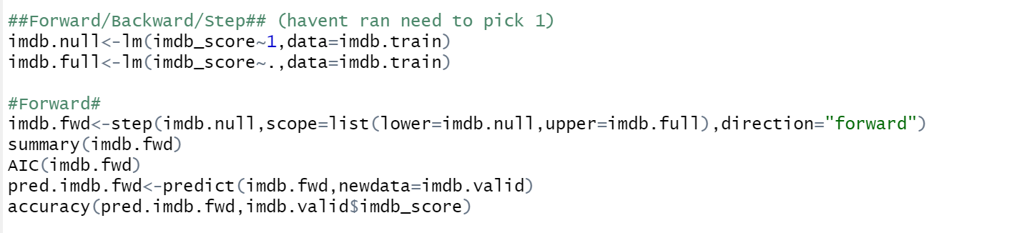
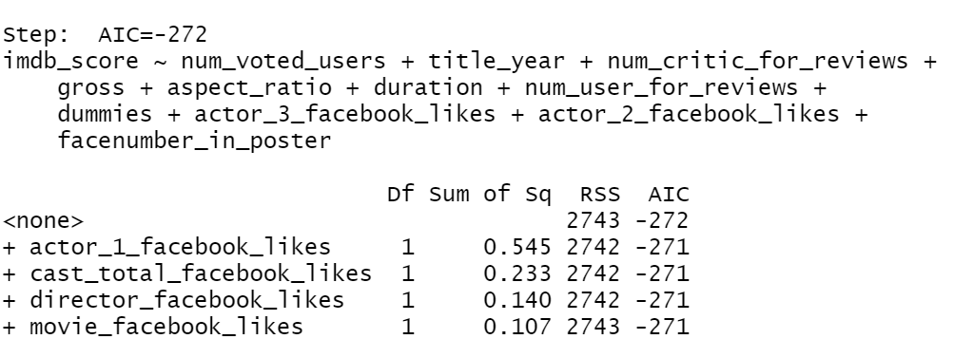
Forward Selection

Slide 12
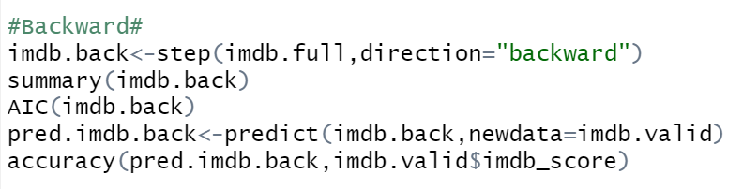
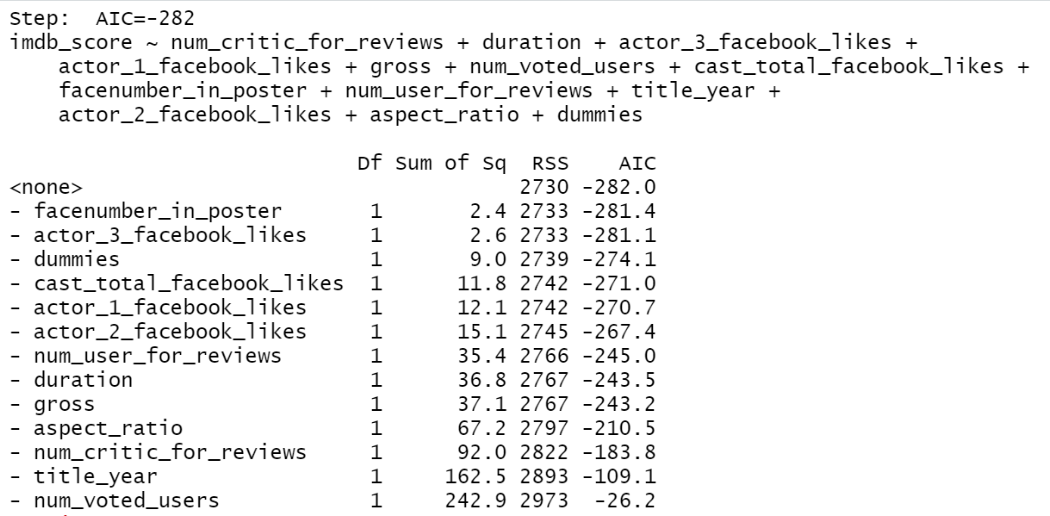
Backward Selection

Slide 13
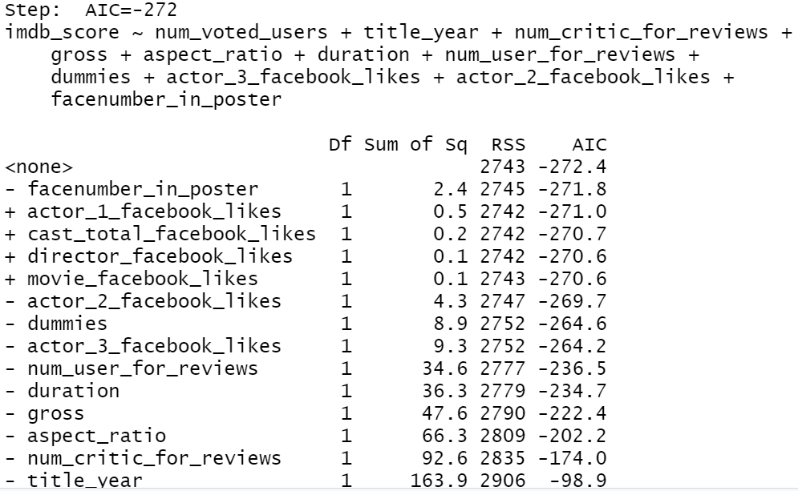
Step Wise

Slide 14
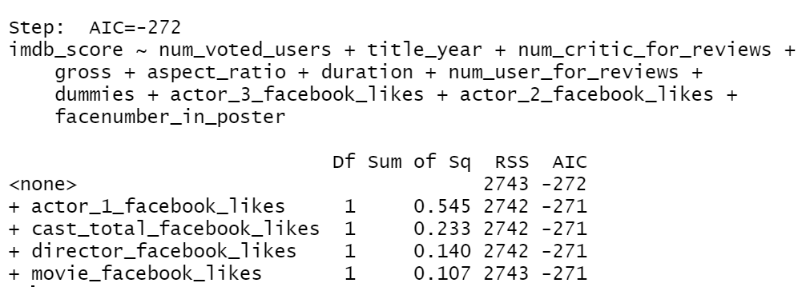
Variable Selection
We chose Forward selection to choose the variables because Forward Selection narrows down significant predictors
Based on Forward Selection, we would choose director_facebook_likes and movie_facebook_likes as they are the combination of lowest Sum of Square and AIC

Slide 15
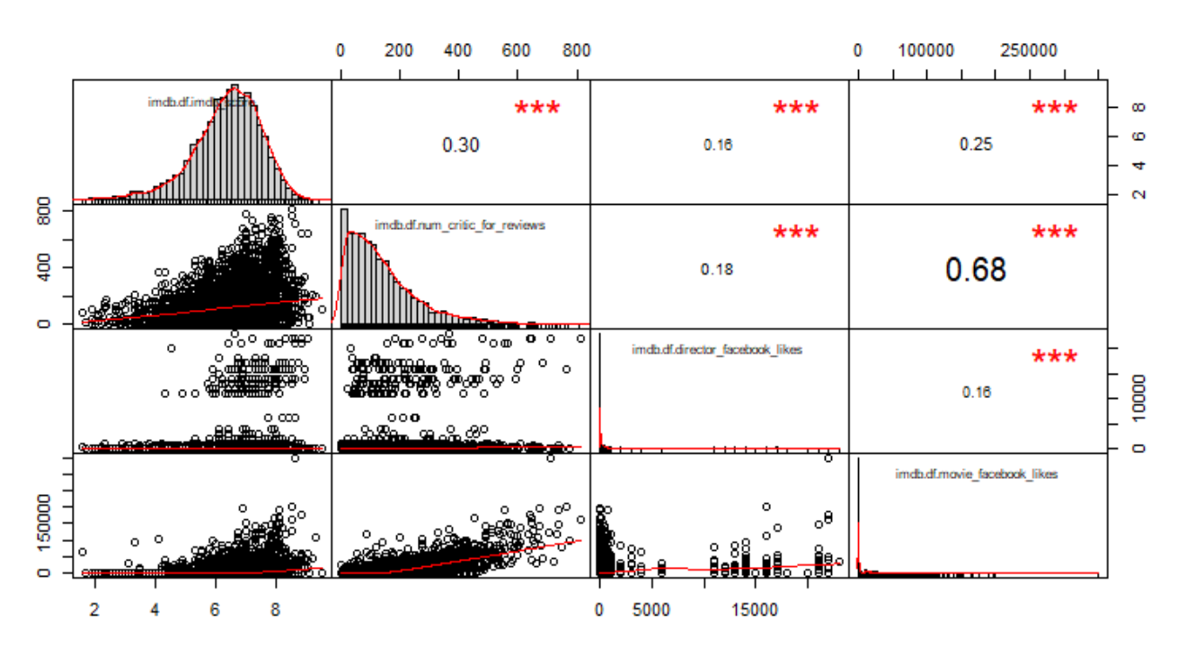
Performance on Validation Data of Simple Linear Regressions
The graph subsequently associated with imdb_score, director_facebook_likes, movie_facebook_likes
There is a high correlation (0.25) between imdb_score & movie_facebook_likes
There are less correlation both happens for imdb_score vs. Director_facebook_likes and Director_facebook_likes vs. Movie_facebook_likes
Although a movie has a high IMDB score and an impressive amount of Facebook likes, it does not mean that the director for the movie is popular.

Slide 16
Comparison Table
Model Name | Description | # of Predictors | Adj R^2 | AIC | ME | RMSE
lm_mv_fblike_score | Simple linear model for movie_fb_likes & imdb_score | 2 | 0.06 | 113537 | - | -
lm_dir_fblike_score | Simple linear model for director_fb_likes & imdb_score | 2 | 0.03 | 94185 | - | -
lm_critic_Score | Simple linear model for num_critics_reviews & imdb_score | 2 | 0.09 | 62206 | - | -
Imdb.mlm | Multiple Linear Regression for all predictors | 147 | 0.365 | 8022 | -0.001 | 0.9
imdb.fwd | Forward Regression | 12 | 0.372 | 7931 | -0.01 | 0.9
imdb.back | Backward Regression | 12 | 0.371 | 7942 | -0.006 | 0.9

Slide 17
Summary of Analysis
By reducing the number of categorical variables in our dataset, and using all but one of our numerical variables, we were able to use raw data to develop our models and determine what gives a movie a high IMDB score.
Based on our Simple Linear Regression, we can conclude that even though a movie has a high IMDB score and many Facebook likes, it does not mean that the director for the movie is popular.
Our group has determined that the Forward Regression (imdb.fwd) was the best for predicting IMDB scores. We came to this conclusion because Forward Selection has the lowest AIC, indicating that it is the best fit model.

